Slide 1
ANSI/ISA-95.00.05 ed4, WD02
Figures in the standard

Slide 2
Figure 1
Information User
GET Equipment
Information Provider
Application Identification Area
Data Area
GET
VERB = GET
SHOW Equipment
Local
processing
Noun = Equipment
ID= “ABC”
Application Identification Area
Data Area
VERB = SHOW
Noun = Equipment
ID= “ABC”
Description = “Simple equipment”
Equipment Property
ID = “Throughput”
Value = “200”
Value Unit of Measure = “PPM”
Description = “Throughput as parts
per minute”
…
SHOW

Slide 3
Figure 2
Data Message
Application
Identification Area
Initiating verbs: GET, CHANGE, CANCEL, PROCESS, NOTIFY, SYNC
Responding verbs: SHOW, CONFIRM, ACKNOWLEDGE, RESPOND
Data Area
Verb
Area
Noun
Area
Objects defined in the Part 2 and Part 4 object models

Slide 4
Figure 3
Data Message
Application
Identification Area
Sender
Identifies the sender of the message
Logical ID
Identifies the return address of the sender
Confirmation
Defines the confirmation option
…
Other sender information
Creation Date
Defines the creation date of the message
…
Other application identification information
Data Area

Slide 5
Figure 4
Information User
GET Equipment
Information
Provider
Application Identification Area
GET
Data Area
VERB = GET
SHOW Equipment
Local
processing
Noun = Equipment
ID= “A*”
Application Identification Area
Data Area
VERB = SHOW
Noun = Equipment
ID= “ABC”
Description = “Simple equipment”
Equipment Property
ID = “Throughput”
Value = “200”
Value Unit of Measure = “PPM”
Description = “Throughput as parts
per minute”
…
SHOW
Noun = Equipment
ID= “A11862”
Description = “Complex equipment”
Equipment Property
ID = “Throughput”
Value = “2000”
Value Unit of Measure = “PPM”
Description = “Throughput as parts
per minute”
…

Slide 6
Information User
Information Provider
Figure 5
GET
Local
processing
SHOW

Slide 7
Information Sender
Information Receiver
Figure 6
PROCESS (Acknowledge Always)
Local
processing
ACKNOWLEDGE
Figure 7
Scheduling
System
Execution
System
Generate
schedule
PROCESS (Acknowledge Always) – Operations Schedule
ACKNOWLEDGE – MODIFIED – Operations Schedule
Local processing
Re-generate
schedule
PROCESS (Acknowledge Always) – Operations Schedule
ACKNOWLEDGE – ACCEPTED
Local processing

Slide 8
Information Sender
Information Receiver
CHANGE (Confirm OnError)
Local processing
error detected
CONFIRM
Information Sender
Information Receiver
Figure 8
CHANGE (Respond Always)
Local processing
error detected
RESPOND

Slide 9
Figure 9
Information User
Information Provider
GET (Confirm Always)
Local processing
no error detected
CONFIRM
SHOW

Slide 10
Figure 10
Information User
Information Provider
GET (Confirm OnError)
Local processing
error detected
CONFIRM

Slide 11
CONFIRM
Application
Identification Area
Figure 11
Data Area
Verb
Area
-
Confirm
Noun
Area
rea
Error Return
Optional additional error description, code or text

Slide 12
Information Provider
Information User
Figure 12
SYNC ADD (Confirm Always)
Local processing
CONFIRM
Information Provider
Information User
Figure 13
SYNC DELETE
Local processing
Information Provider
Information User
SYNC CHANGE with Confirm Flag
CONFIRM
Local processing

Slide 13
Figure 14
Information Provider
NOTIFY Operations Event
Information User(s)
Application Identification Area
Event
Occurs
Data Area
NOTIFY
VERB = NOTIFY
Possible
Local
processing
Noun = Operations Event
ID= “Material Arrived”
Operations Event Definition = “Material Arrived”

Slide 14
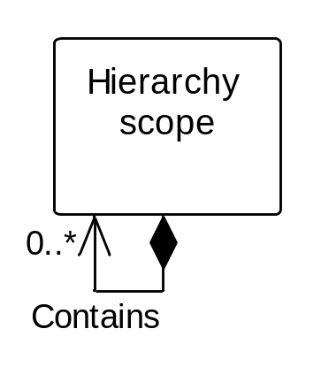
Figure 15
Information About
Hierarchy Scopes

Slide 15
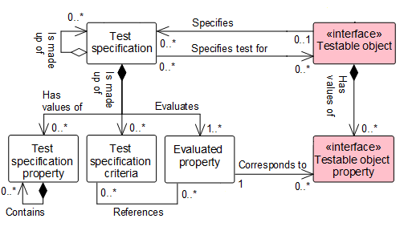
Figure 16
Information About
Tests
Qualification Test Specification is the Testing Specification for the Personnel Class and Person (defined as implementing the Testable Object <<interface>> class – See ISA 95.00.02 on the Operations Test Model).

Slide 16
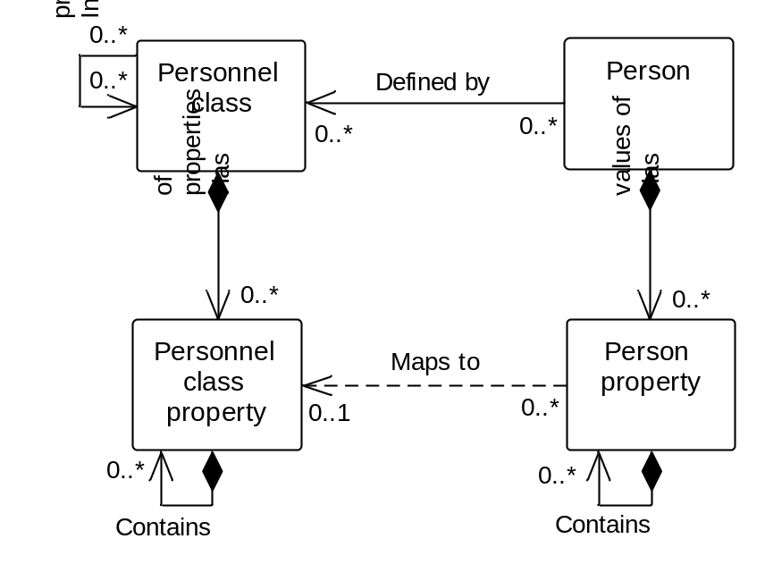
Figure 19
Information About
Personnel Classes
Information
About Persons
Information About
Tests
Personnel class and person implement the testable object <<interface>> class (See ISA 95.00.02 on the Operations Test Model). Personnel class property and person property implement the testable object property <<interface>> class. See clause 6.4 for the test specification transaction definitions.

Slide 17
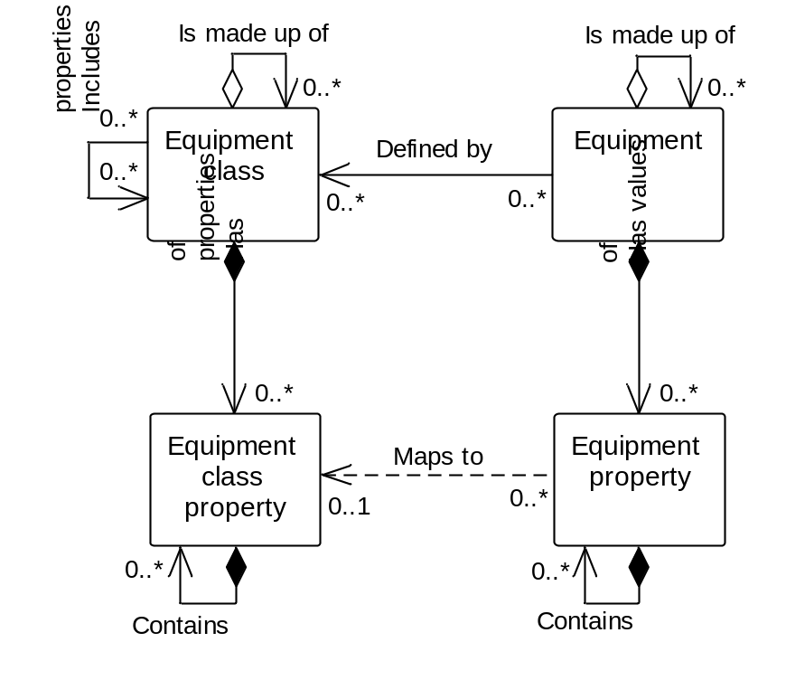
Figure 20
Information About
Equipment Classes
Information
About Equipment
Information About
Tests
Equipment class and equipment implement the testable object <<interface>> class (See ISA 95.00.02 on the Operations Test Model). Equipment class property and equipment property implement the testable object property <<interface>> class. See clause 6.4 for the test specification transaction definitions.

Slide 18
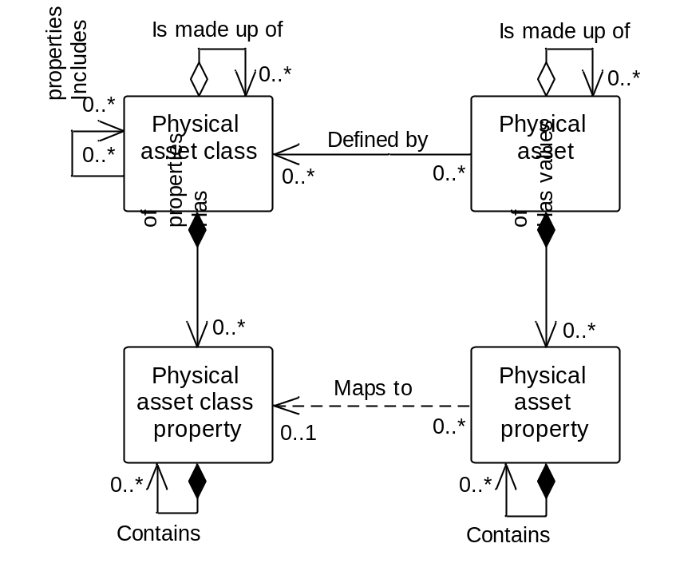
Figure 21
Information About
Physical Asset Classes
Information
About Physical Assets
Information About
Tests

Slide 19
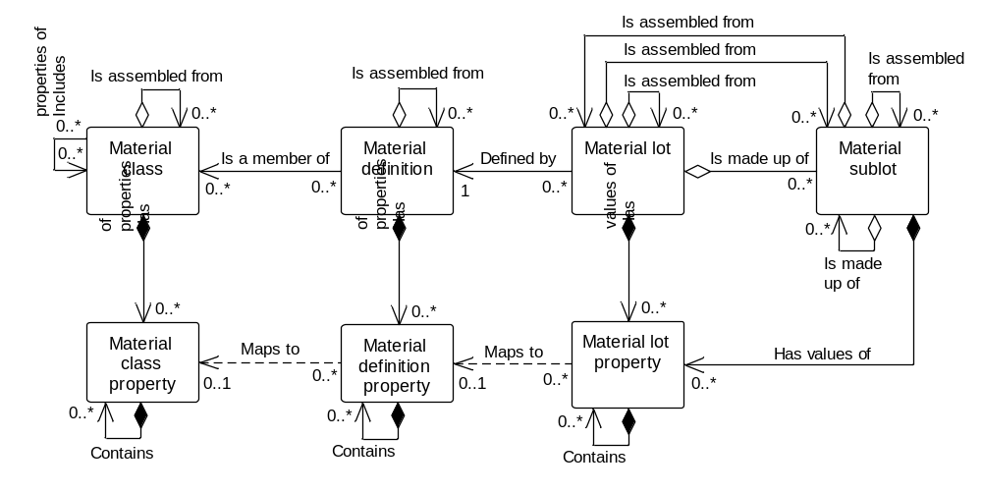
Figure 22
Information About
Material Classes
Information About
Material Definitions
Information
About Material Lots
Information About
Tests
Information
About Material Sublots
Material Test Specification is the Testing Specification for the Material Class, Material Definition, Material Lot and Material Sublot (defined as implementing the Testable Object <<interface>> class – See ISA 95.00.02 on the Operations Test Model).

Slide 20
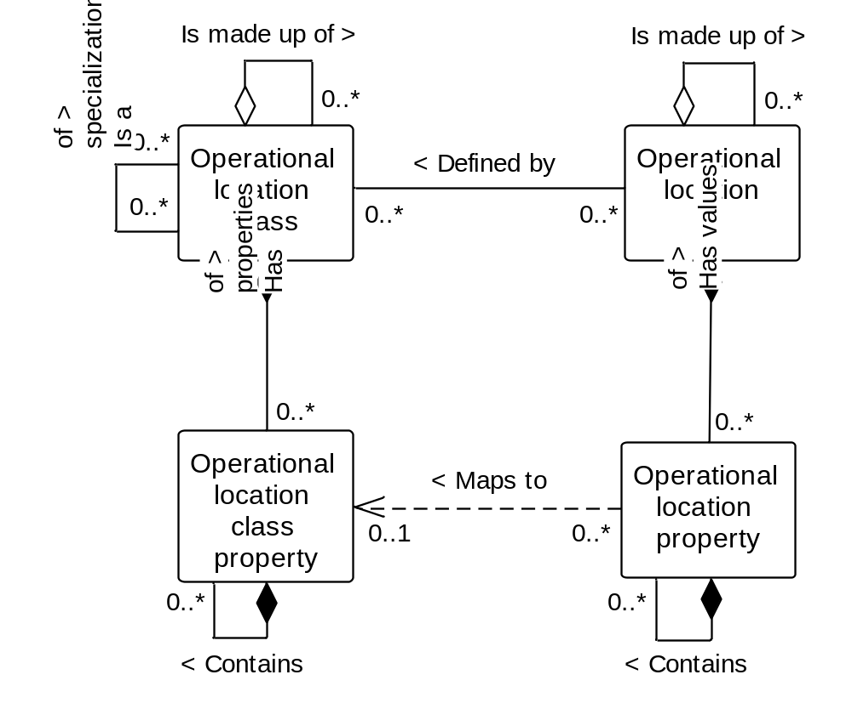
Figure 23
Information About
Operational Location Classes
Information About
Operational Locations

Slide 21
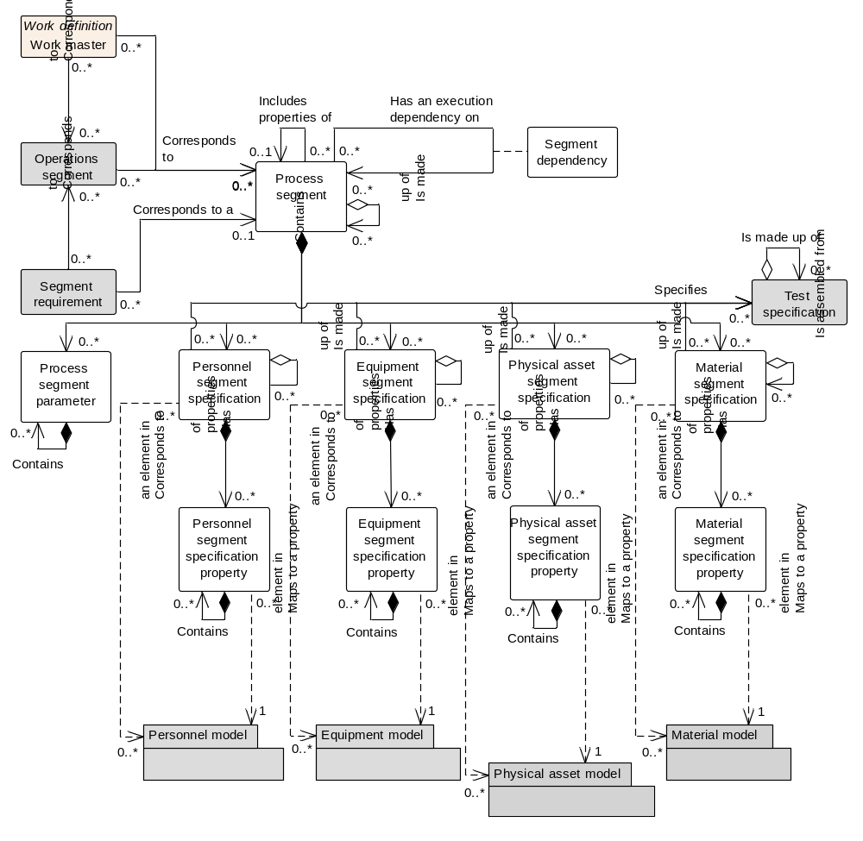
Figure 24
Information About
Process Segments

Slide 22
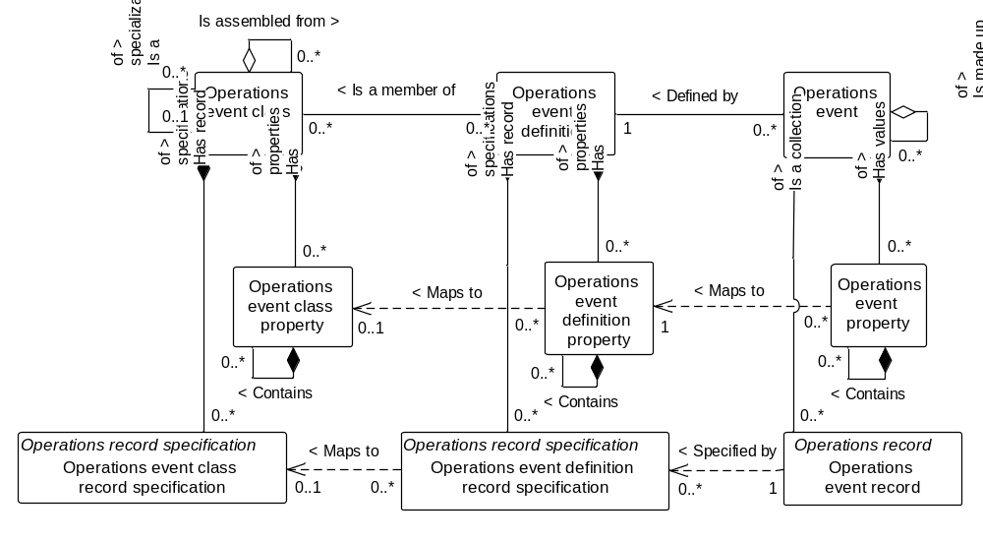
Information About
Operations Event
Classes
Information About
Operations Event
Definitions
Information About
Operations Events

Slide 23
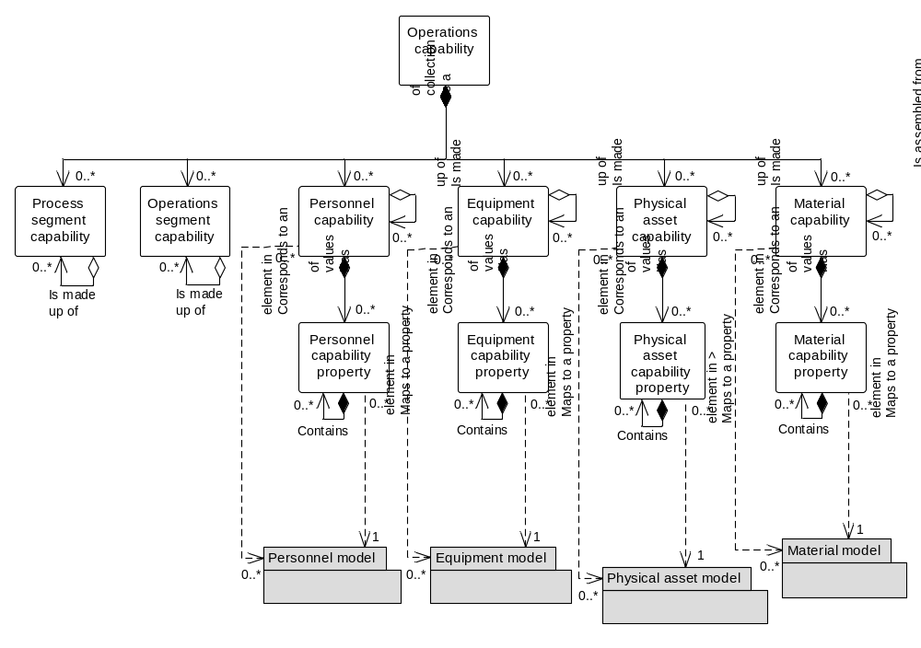
Information About
Operations Capability

Slide 24
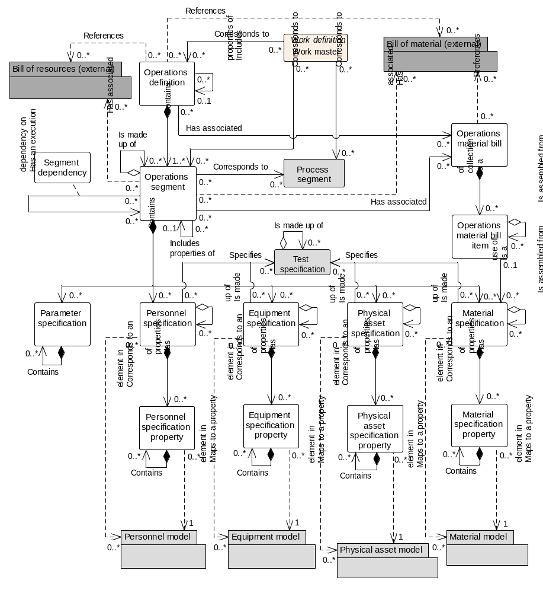
Information About
Operations Definition

Slide 25
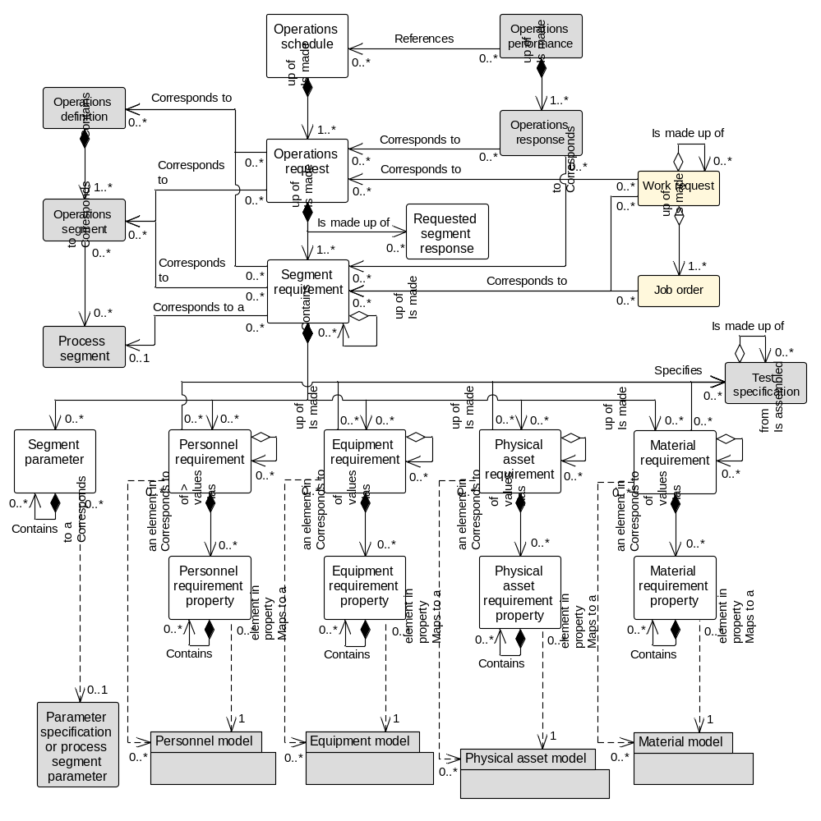
Information About
Operations Schedule
New: Operations Schedule

Slide 26
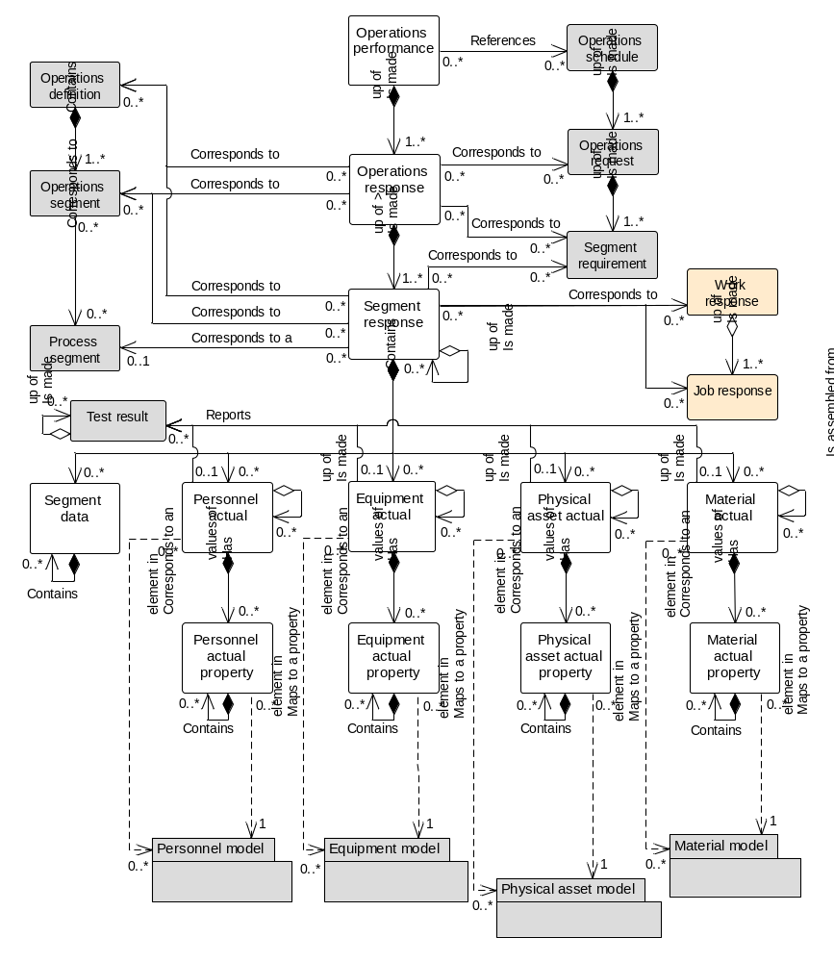
Information About
Operations Performance
Updated: Operations Performance

Slide 27
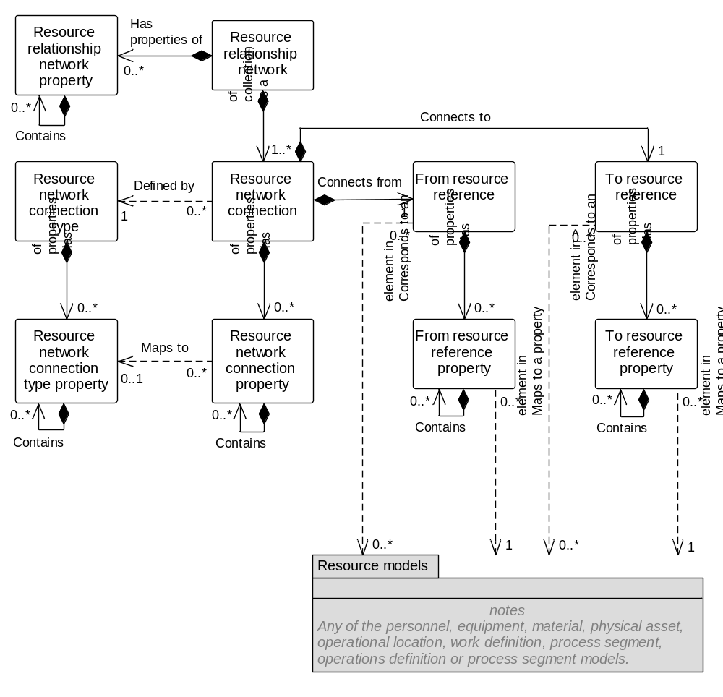
Information About
A Resource
Relationship Network
Information About
A Resource
Relationship Network Type

Slide 28
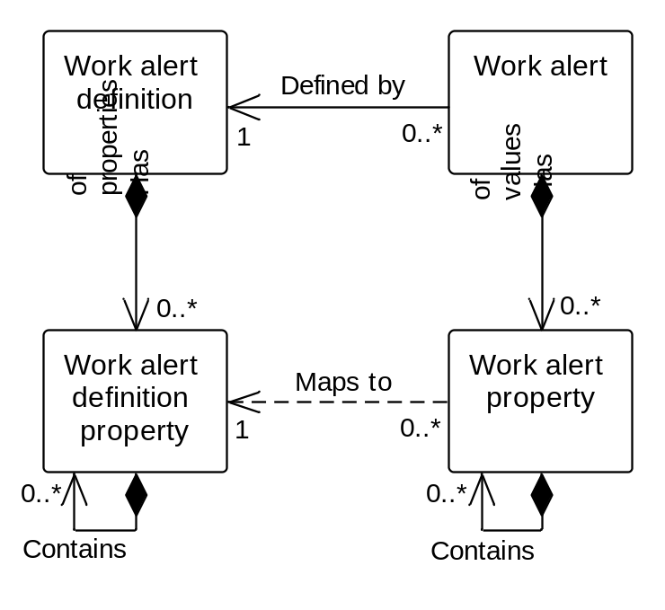
Updated: Work Alert
Information about a
Work Alert Definition
Information about a
Work Alert

Slide 29
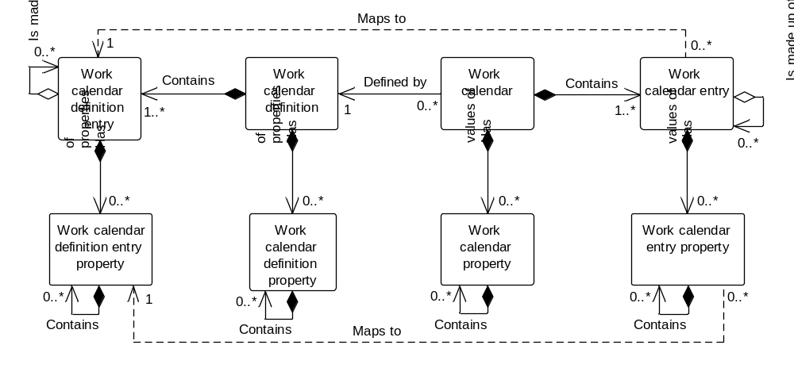
Updated 2.0: Work Calendar
Information about a
Work calendar definition
Information about a
Work calendar

Slide 30
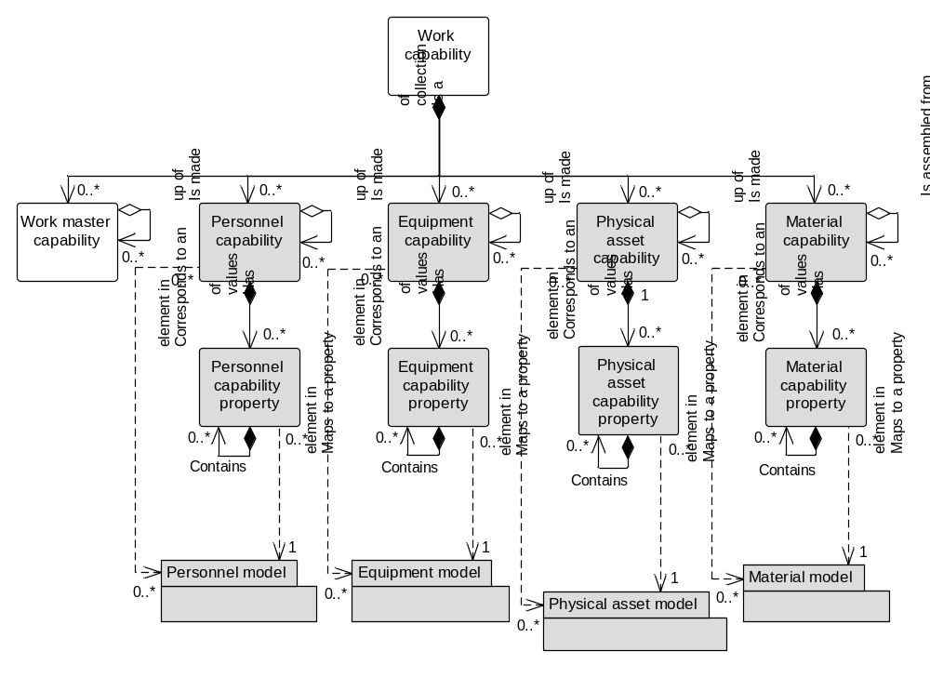
Updated: Work capability
Information about a
Work Capability

Slide 31
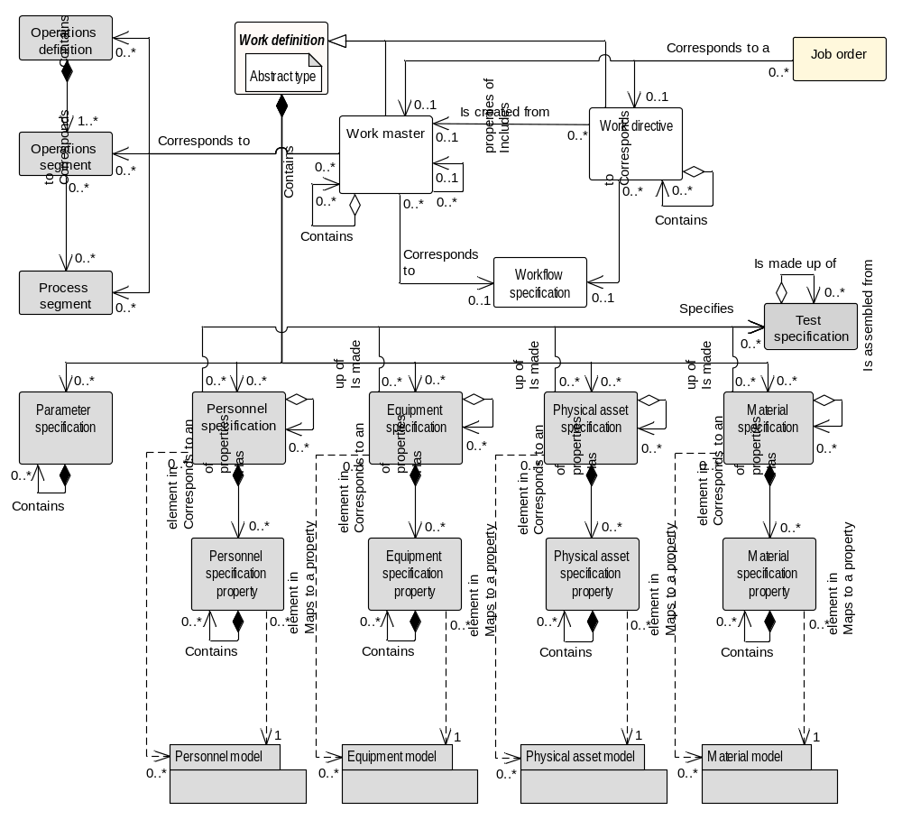
Updated: Work Definition
Information about a
Work Master
Information about a
Work Directive

Slide 32
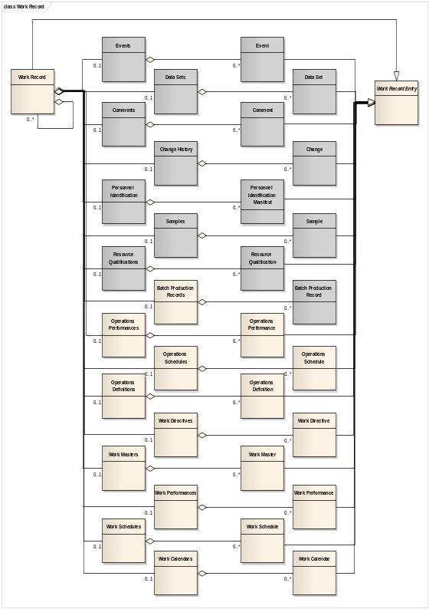
Work record
Information about a
Work record

Slide 33
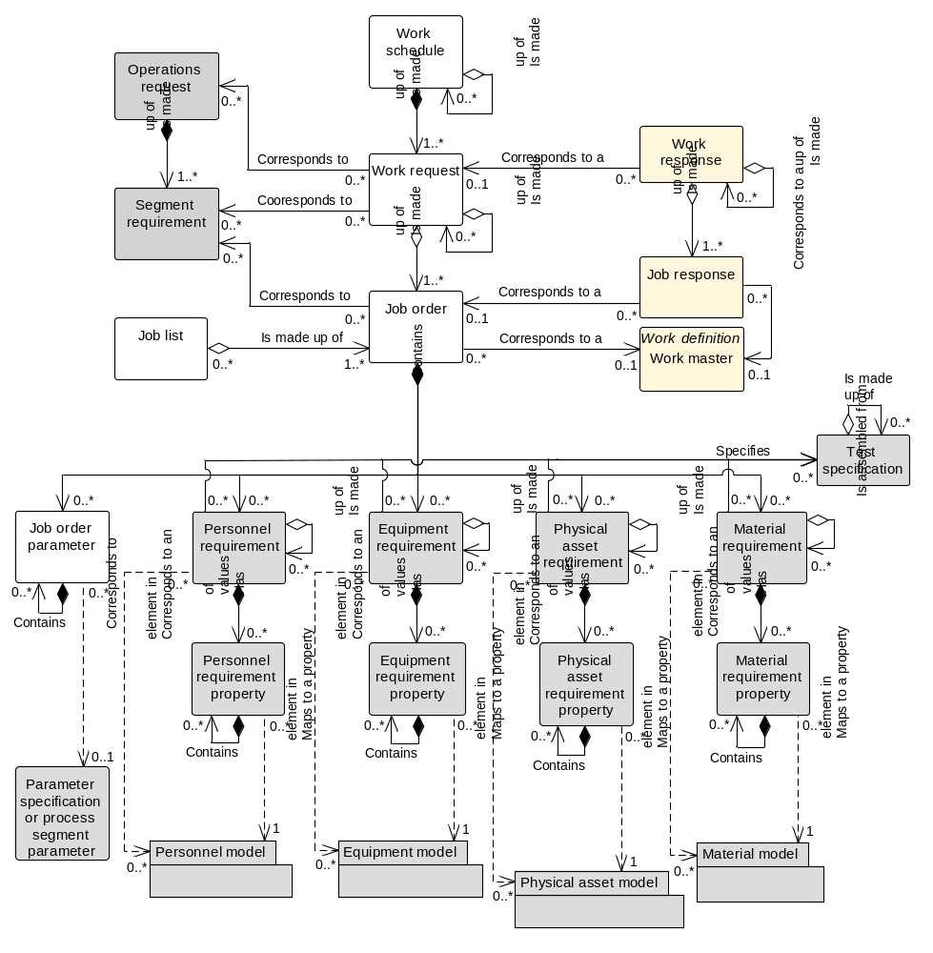
Updated: Work Schedule
Information about a
Job List
Information about a
Work Schedule

Slide 34
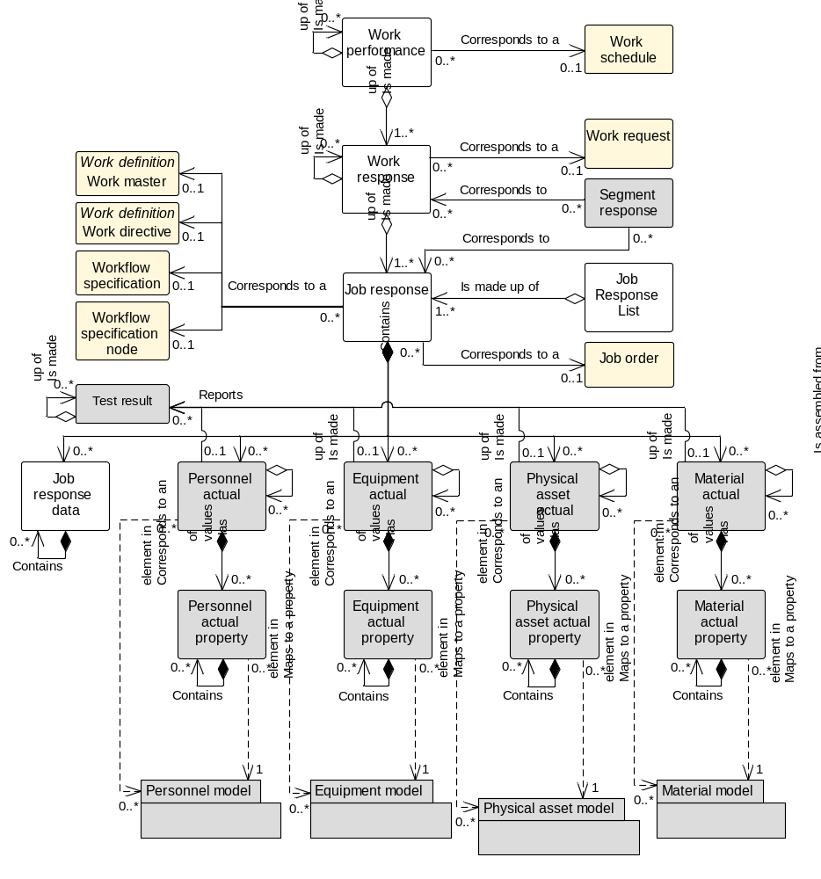
Updated: Work Performance
Information about a
Work Performance
Information about a
Job Response
Information about a
Job Response List

Slide 35
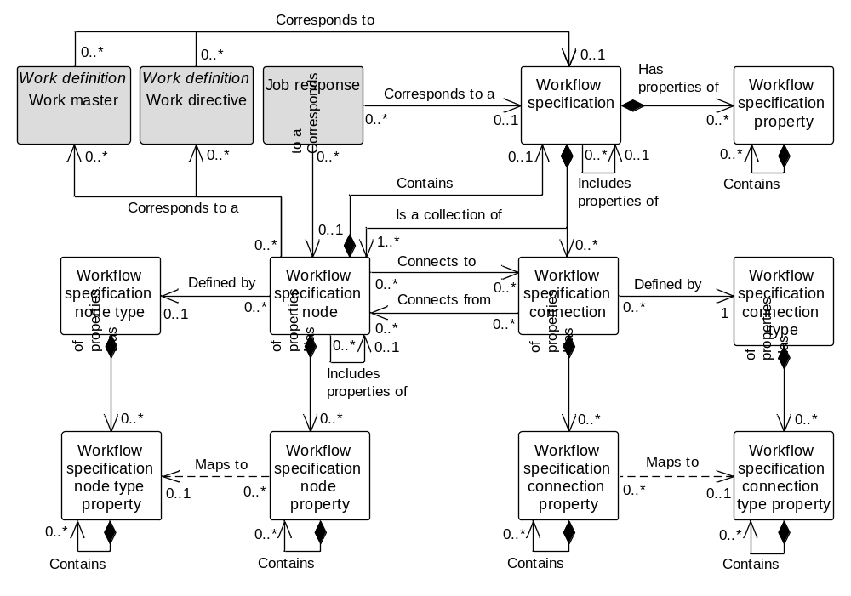
Updated: Workflow Specification
Information about a
Workflow Specification
Information about a
Workflow Specification Type

Slide 36
Transaction profile
Transaction
Profile
Is made up of
1..n
Supported Action

Slide 37
Operations Planning & Scheduling Scenario
Level 4
PLM
Level 4
Asset Mgt
Level 4
Operations Planning & Capacity Analysis
Level 4
Inventory Mgt
SHOW Equipment
PROCESS Operations Schedule
PROCESS Operations Performance
SHOW Operations Definition
PROCESS Operations Capability
PROCESS MaterialSubLot
GET Operations Definition
GET Equipment
Level 3
Product Definition Management
Level 3
Operations Resource Mgt
Level 3
Detailed Scheduling
Level 3
Operations Tracking
SYNC Work Schedule

Slide 38
Business Process Scenario #1a
PUSH MODEL – Operations Schedule / Operations Performance
ERP
Level 4
Operations Scheduling
MOM
Level 3
PROCESS – Operations Schedule
PROCESS – Operations Performance
Some work
complete
PROCESS* – Operations Performance
All work finished
Scenario assumptions:
1. ERP send Operations schedule to MOM for processing
2. MOM (Manufacturing Operations Management) sends Operations performance to ERP for processing
* Message contains a FINAL flag to indicate that the message is the final Operations performance for the associated Operations schedule.

Slide 39
Business Process Scenario #3a
PULL MODEL – Operations Schedule / Operations Performance
ERP
Level 4
GET – Operations Schedule
MOM
Level 3
SHOW – Operations Schedule
Some work
complete
GET – Operations Performance~
SHOW – Operations Performance
All work finished
GET – Operations Performance~
SHOW* – Operations Performance
Scenario assumptions:
1. MOM requests Operations schedule from ERP
2. ERP requests Operations performance from MOM
~ The GET Operations performance message contains an identification of a Operations schedule (Operations Performance / Operations Schedule ID)
* The final SHOW Operations performance message contains a flag to indicate that the message is the final Operations performance for the associated Operations schedule.

Slide 40
Business Process Scenario #1a
PUBLISH MODEL – Operations Schedule / Operations Performance
ERP
Level 4
Operations Scheduling
MOM
Level 3
SYNC ADD – Operations Schedule
SYNC ADD – Operations Performance
Some work
complete
SYNC CHANGE* – Operations Performance
All work finished
Scenario assumptions:
1. MOM subscribes to Operations schedules.
2. ERP subscribes to Operations performances.
3. ERP publishes Operations schedule.
4. MOM publishes initial Operations performance with a SYNC ADD message.
5. MOM publishes subsequent Operations performances for the schedule with SYNC CHANGE messages.
* Message contains a FINAL flag to indicate that the message is the final Operations performance for the associated Operations schedule.

Slide 41
Detailed
Scheduling
NOTIFY Operations Event
Data Collection
Execution
Management
Application Identification Area
Schedule
Released
Data Area
NOTIFY
VERB = NOTIFY
Published
Noun = Operations Event
ID= “Work Scheduled”
NOTIFY Operations Event
Work
Started
Application Identification Area
NOTIFY
Data Area
Published
VERB = NOTIFY
Noun = Operations Event
ID= “Resources Acquired”

Slide 42
Business Process Scenario #1b
PUSH MODEL – Operations Schedule Changes
ERP
Level 4
Operations Scheduling
PROCESS – Operations Schedule
MOM
Level 3
PROCESS – Operations Performance
Some work
complete
Schedule
changes
CHANGE – Operations Schedule
PROCESS – Operations Performance
Some more
work complete
PROCESS* – Operations Performance
All work finished
Scenario assumptions:
1. ERP sends Operations schedule to MOM for processing
2. MOM sends Operations performance to ERP for processing
3. ERP makes change to schedule and sends to MOM for processing
* Message contains a FINAL flag to indicate that the message is the final Operations performance for the associated Operations schedule.

Slide 43
Business Process Scenario #1b
PUBLISH MODEL – Operations Schedule Changes
ERP
Level 4
Operations Scheduling
SYNC ADD – Operations Schedule
MOM
Level 3
SYNC ADD – Operations Performance
Some work
complete
Schedule
changes
SYNC CHANGE – Operations Schedule
SYNC CHANGE – Operations Performance
Some more
work complete
SYNC CHANGE* – Operations Performance
All work finished
Scenario assumptions:
1. MOM subscribes to Operations schedules.
2. ERP subscribes to Operations performances.
3. ERP publishes Operations schedule.
4. MOM publishes initial Operations performance with a SYNC ADD message.
5. ERP changes schedule and republishes with SYNC CHANGE
6. MOM publishes subsequent Operations performances for the schedule with SYNC CHANGE messages.
* Message contains a FINAL flag to indicate that the message is the final Operations performance for the associated Operations schedule.

Slide 44
Business Process Scenario #1c
PUSH MODEL – Operations Schedule Canceled
ERP
Level 4
Operations Scheduling
PROCESS – Operations Schedule
MOM
Level 3
Schedule
invalidated
CANCEL – Operations Schedule
Scenario assumptions:
1. ERP sends Operations schedule to MOM for processing
2. ERP cancels schedule before actual Operations starts, and sends CANCEL of schedule to MOM

Slide 45
Business Process Scenario #1c
PULL and PUSH MODEL – Operations Schedule Canceled
ERP
Level 4
Operations Scheduling
GET – Operations Schedule
MOM
Level 3
SHOW – Operations Schedule
Schedule
invalidated
CANCEL – Operations Schedule
Scenario assumptions:
1. MOM requests Operations schedule from ERP.
2. ERP cancels schedule before actual Operations starts, and sends CANCEL of schedule to MOM.

Slide 46
Business Process Scenario #1d
PUSH MODEL – Daily Operations Performance
ERP
Level 4
MOM
Level 3
Operations Tracking
PROCESS – Operations Performance (May 24, 2009)
PROCESS – Operations Performance (May 25, 2009)
Scenario assumptions:
1. MES sends daily Operations performance to ERP
2. Scope of Operations performance (which Operations lines, etc…) and timing of the publication (daily, weekly, time published) is not defined in a transaction message but is determined to in an out-of-band agreement.

Slide 47
Business Process Scenario #3d
PULL MODEL – Daily Operations Performance
ERP
Level 4
MOM
Level 3
GET – Operations Performance (May 24, 2009)
SHOW – Operations Performance (May 24, 2009)
GET – Operations Performance (May 25, 2009)
SHOW – Operations Performance (May 25, 2009)
Scenario assumptions:
1. ERP requests Operations performance from MOM on a daily schedule

Slide 48
Business Process Scenario #2d
PUBLISH/SUBSCRIBE MODEL – Daily Operations Performance
ERP
Level 4
MOM
Level 3
SYNC ADD – Operations Performance (May 24, 2009)
SYNC ADD – Operations Performance (May 25, 2009)
Scenario assumptions:
1. ERP subscribes to daily Operations performance from MOM
2. MOM publishes daily Operations performance
3. Scope of Operations performance (which Operations lines, etc…) and timing of the publication (daily, weekly, time published) is not defined in a transaction message but is determined to in an out-of-band agreement.

Slide 49
Business Process Scenario #1h
PUSH/PULL MODEL – Operations Schedule based on Operations Capability
ERP
Level 4
Operations Scheduling
GET – Operations Capability
MOM
Level 3
Execution
SHOW – Operations Capability
PROCESS – Operations Schedule
PROCESS – Operations Performance
Some work
complete
PROCESS – Operations Performance
Some more
work complete
PROCESS – Operations Performance
All work finished
Scenario assumptions:
1. ERP requests Operations capability for the planning period
2. MOM sends Operations capability to ERP
3. ERP sends Operations schedule to MOM for processing
4. MOM sends Operations performance to ERP reflecting partial order completion
5. MOM sends Operations performance to ERP reflecting partial order completion
6. MOM sends Operations performance to ERP reflecting completion of order

Slide 50
Business Process Scenario #1h
PUBLISH and PUSH MODEL – Operations Schedule based on Operations Capability
ERP
Level 4
Operations Scheduling
MOM
Level 3
Execution
SYNC ADD – Operations Capability
SYNC ADD – Operations Schedule
PROCESS – Operations Performance
Some work
complete
PROCESS – Operations Performance
Some more
work complete
PROCESS* – Operations Performance
All work finished
Scenario assumptions:
1. ERP subscribes to Operations capability.
2. MOM subscribes to Operations schedules.
3. MOM publishes Operations capability on a regular schedule, e.g. every 2 days,
4. ERP generates a Operations schedule and publishes it.
5. MOM sends Operations performance to ERP reflecting partial order completion.
6. MOM sends Operations performance to ERP reflecting partial order completion.
7. MOM sends Operations performance to ERP reflecting completion of order.
* Message contains a FINAL flag to indicate that the message is the final Operations performance for the associated Operations schedule.

Slide 51
Not sure this is in part 5?
Business Process Scenario #1e
PUSH MODEL – Operations Schedule / Capability Changes
ERP
Level 4
MOM
Level 3
Operations Resource Management
PROCESS – Operations Schedule
PROCESS – Operations Capability
Schedule
changes
CHANGE – Operations Schedule
Scenario assumptions:
1. ERP send Operations schedule to MOM for processing
2. MOM sends updated Operations capability to ERP for processing
3. Scope of Operations capability (which Operations lines, etc…) and timing of the publication (daily, weekly, time published) is not defined in a transaction message but is determined to in an out-of-band agreement.
4. ERP changes schedule based on new capability and sends CHANGE to MOM

Slide 52
New Business Process Scenario #1j
PUSH/PULL MODEL – Operations Schedule Changes using Operations Capability as input
ERP
Level 4
Operations Scheduling
MOM
Level 3
PROCESS – Operations Schedule
PROCESS – Operations Performance
Some work
complete
GET – Operations Capability
SHOW – Operations Capability
Schedule
changes
CHANGE – Operations Schedule
PROCESS – Operations Performance
Some more
work complete
PROCESS – Operations Performance
All work finished
Scenario assumptions:
1. ERP sends Operations schedule to MOM for processing
2. MOM sends Operations performance to ERP for processing
3. ERP requests Operations capability from MOM
4. MOM sends Operations capability to ERP
5. ERP makes change to schedule and sends to MOM for processing
6. MOM sends Operations performance to ERP reflecting partial order completion
7. MOM sends Operations performance to ERP reflecting completion of order

Slide 53
Information Provider
Application A
- Detailed Scheduling
Information User
Application B
- Execution Management
NOTIFY Operations Event
Application Identification Area
Event
Occurs
Data Area
NOTIFY
VERB = NOTIFY
Local
processing
Noun = Operations Event
ID= “20180303G12334”
Operations Event Definition = “Work Scheduled”
Information User
Application A
- Detailed Scheduling
Information Provider
Application B
- Execution Management
NOTIFY Operations Event
Application Identification Area
NOTIFY
Data Area
Event
Occurs
Possible
Local
processing
VERB = NOTIFY
Noun = Operations Event
ID= “20180304Y66787”
Operations Event Definition = “Work Accepted”

Slide 54
Not sure this is in part 5?
Business Process Scenario #2a
PUBLISH/SUBSCRIBE MODEL – Operations Schedule / Operations Performance
ERP
Level 4
SYNC ADD – Operations Schedule
MES
Level 3
SYNC ADD – Operations Performance
Some work
complete
SYNC CHANGE – Operations Performance
More work
complete
SYNC CHANGE* – Operations Performance
All work finished
Scenario assumptions:
1. ERP publishes Operations schedules, MES subscribes to changes
2. MES publishes Operations responses, ERP subscribes to changes
3. MES publishes SYNC ADD on first response and SYNC CHANGE on subsequent responses
* Message contains a FINAL flag to indicate that the message is the final Operations performance for the associated Operations schedule.

Slide 55
Business Process Scenario #2b
PUBLISH/SUBSCRIBE MODEL – Operations Schedule Changes
ERP
Level 4
SYNC ADD – Operations Schedule
MES
Level 3
SYNC ADD – Operations Performance
Some work
complete
Schedule
changes
SYNC CHANGE – Operations Schedule
SYNC CHANGE – Operations Performance
Some more
work complete
SYNC CHANGE* – Operations Performance
All work finished
Scenario assumptions:
1. ERP publishes Operations schedules, MES subscribes to changes
2. MES publishes Operations responses, ERP subscribes to changes
3. ERP changes Operations schedule and sends changed Operations schedule using SYNC CHANGE to MES
* Message contains a FINAL flag to indicate that the message is the final Operations performance for the associated Operations schedule.

Slide 56
A.9.2 – Publish and push model, Material qty changed
Business Process Scenario #1g
Mixed MODEL – Material Lot added, material lot quantity changed
ERP
Level 4
MOM
Level 3
New material lot
is available
SYNC ADD – Material Lot (quantity = 400)
CHANGE – Material Lot (quantity = 300)
Material lot
quantity changed
CHANGE – Material Lot (quantity = 200)
Material lot
quantity changed
CHANGE – Material Lot (quantity = 0)
Material lot
quantity changed
Material lot no
longer available
SYNC DELETE – Material Lot
Scenario assumptions:
1. ERP publishes material lot information, MOM subscribes
2. MOM sends quantity changes in material lot to ERP
3. ERP send SYNC DELETE when material lot is no longer available

Slide 57
A.9.3 – Push and pull model, Material qty changed
Business Process Scenario #1g
PUSH and PULL MODEL – Material Lot added, material lot quantity changed
ERP
Level 4
MOM
Level 3
New material lot
is available
GET – Material Lot (status = “New”)
SHOW – Material Lot (quantity = 400)
CHANGE – Material Lot (quantity = 300)
Material lot
quantity changed
CHANGE – Material Lot (quantity = 200)
Material lot
quantity changed
CHANGE – Material Lot (quantity = 0)
Material lot
quantity changed
Scenario assumptions:
1. MOM requests material lot information from ERP
2. ERP sends information on new material lots (lots with no changes)
3. MOM pushes quantity changes in material lot to ERP

Slide 58
A.9.1 - Push model, Material qty changed
Business Process Scenario #1f
PUSH MODEL – Material Lot added, material lot quantity changed
ERP
Level 4
MOM
Level 3
New material lot
is available
PROCESS – Material Lot (quantity = 400)
CHANGE – Material Lot (quantity = 300)
Material lot
quantity changed
CHANGE – Material Lot (quantity = 200)
Material lot
quantity changed
CHANGE – Material Lot (quantity = 0)
Material lot
quantity changed
Material lot no
longer available
CANCEL – Material Lot
Scenario assumptions:
1. Consumable material arrives at the facility and is entered into the ERP
2. ERP send material lot information to MOM for processing
3. MOM sends quantity changes in material lot to ERP as material is consumed
4. ERP sends CANCEL when material lot is no longer available

Slide 59
Not sure this is in part 5?
Business Process Scenario #2c
PUBLISH/SUBSCRIBE MODEL – Operations Schedule Canceled
ERP
Level 4
SYNC ADD – Operations Schedule
MES
Level 3
Schedule
canceled
SYNC DELETE – Operations Schedule
Scenario assumptions:
1. ERP publishes Operations schedules, MES subscribes to changes
2. ERP cancels the schedule before Operations starts and sends SYNC DELETE to MES

Slide 60
Business Process Scenario #3b
GET/SHOW MODEL – Operations Schedule Changes
ERP
Level 4
GET – Operations Schedule
MES
Level 3
SHOW – Operations Schedule
Some work
complete
Schedule
changes
GET – Operations Schedule
SHOW – Operations Schedule
All work finished
GET – Operations Performance
SHOW* – Operations Performance
Scenario assumptions:
1. MES requests Operations schedule from ERP
2. ERP requests Operations performance from MES
3. ERP changes Operations schedule and returns changed schedule on next request
* Message would contain a flag to indicate that the message is the final Operations performance for the associated Operations schedule.
Not sure this is in part 5?

Slide 61
Not sure this is in part 5?
Business Process Scenarios #1, #2
Operations Request/Capability
Operations Request/Response
Level 4
Level 3
Planning
SYNC ADD – Operations Schedule
Determine if can be done and how it can be done
SYNC ADD – Operations Capability
Confirm Schedule
SYNC ADD – Operations Schedule
SYNC CHANGE – Operations Performance
Do some work
SYNC CHANGE – Operations Performance
Work Completed
Scenario assumptions:
1. Level 4 owns the Operations request, Level 3 subscribes to changes
2. Level 3 owns Operations response, Level 4 subscribes to changes
3. Level 3 owns Operations capability, Level 4 subscribes to changes
4. Level 4 generates the Operations schedule

Slide 62
High Level Business Process Scenario #2
Level 4
Level 3
Planning
SYNCH ADD – Operations Request
Determine if can be done and how it can be done
Synch Add – Operations Capability
Confirm Schedule
Process – Operations Request
PROCESS – Operations Response
Do work
Resource availability changes
SYNCH CHANGE – Operations Capability
Reschedule Schedule
SYNCH CHANGE – Operations Request
Finish work
Not sure this is in part 5?

Slide 63
Annex E - Object model with composite relationships
Information About
Operations Schedule
Composite
Relationship
Operations
Schedule
Is made up of
May correspond
to an <
1..n
Work Definition
Operations
Request
Is made up of
May correspond
to an <
1..n
0..n
Process Segment
Segment
Requirement
Requested
Segment
Response
Corresponds
to an <
May contain
0..n
May contain
0..n
0..n
0..n
0..n
0..n
Segment
Parameter
Personnel
Requirement
Equipment
Requirement
Physical Asset
Requirement
Material
Requirement
0..n
0..n
Is assem bled
from
May be made up of
1..n
1..n
1..n
1..n
Personnel
Requirement
Property
Equipment
Requirement
Property
Physical Asset
Requirement
Property
Material
Requirement
Property
Corresponds to
element in the
Corresponds to
element in the
Corresponds to
element in the
Corresponds to
element in the

Slide 64
Annex E: Example of multiple composite objects
Material sublots can be
exchanged the context of the Lot
Composite
Relationship
Is assembled from
Is assembled from
Is assembled from
Is assembled from
0..n
0..n
0..n
0..n
0..n
0..n
Material
Class
Defines
a grouping
Material
Definition
0..n
Material Lot
Made up of
Material
Sublot
0..n
0..n
1..1
Defined by
0..n
Has
properties
of
Has
properties
of
Is tested
by a >
Has
values for
0..n
Is tested
by a >
Has
values for
Is tested
by a >
0..n
0..n
May be made up
of sublots
0..n
Material Test
Specification
0..n
Records the
execution of
Is tested
by a >
0..n
0..n
Material Test
Result
Is tested
by a >
Defines a
procedure
for
obtaining a
0..n
0..n
0..n
0..n
Material
Class
Property
Material
Definition
Property
0..n
0..n
Material Lot
Property
0..n
May
map to
Maps to
Expected usage was used to
determine where to place Material Test Result

Slide 65
Not sure this is in part 5?
Person
ID: 101
Name: John Smith
Person
ID: 101
Name: John Smith
XML Data
Person
Property
ID: dob
Description: Birthday
Value: 23-03-1945
Value Unit Of Measure: DD-MM-YYYY
Person
ID: 101
Name: John Smith
Person
Property
ID: date-du-naissance
Description: Birthday
Value: 1945-03-23
Value Unit Of Measure: YYYY-MM-DD
Adapter
Adapter
Person
Property
ID: date_of_birth
Description: Birthday
Value: 1945-03-23
Value Unit Of Measure: YYYY-MM-DD
dob = date_of_birth
Value = 23-03-1945
UOM = DD-MM-YYYY
date-du-naissance = date_of_birth
Value =1945-02-23
UOM – YYYY-MM-DD

